Slide 1
Section 2.1 Graphs

Slide 2
Points and Ordered Pairs

Slide 3
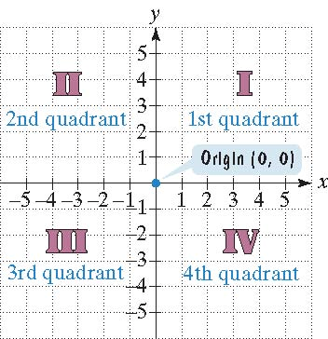
Plot points on the rectangular coordinate system. Plot the x coordinate first then the y coordinate. This is an ordered pair of real numbers. (x,y)

Slide 4
Example
Plot the following points:
(-4,3), (-1,-1), (0,3), (2,-4), (3,0)

Slide 5
Linear Equation with two variables
2x+3y=12
Determine if the given ordered pairs are solutions to the given equation.
(3,2)
(-4,6)
(0,4)
(-30,24)

Slide 6
Graphs of Equations

Slide 7
Example
Graph the following equation and construct a table:
x+y=3
x | y
0
1
2

Slide 8
Intercepts

Slide 9
Example
Find the x and y intercepts and graph the equation after plotting a few more points.
2x+y=4
x | y
 | 0
0

Slide 10
Intercepts
y- intercept : set x = 0, then solve for y
x- intercept: Set y=0, then solve for x

Slide 11
For the following lines, determine the x- and y-intercepts. Be sure to indicate which one is which.
x-y=5
y=3x+2
1) (5,0) and (0,-5)
2) (-2/3,0), (0,2)

Slide 12
Interpreting Information Given by Graphs

Slide 13
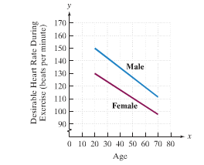
What is the desirable heart rate of a 20 year old woman during exercise?
What is the desirable heart rate of a 20 year old man during exercise?

Slide 14

Graph the following equation by letting x=-2,-1,0,1,2.
x | y
-2
-1
0
1
2
(b)
(c) (d)

Slide 15
The Slope of a Line

Slide 16
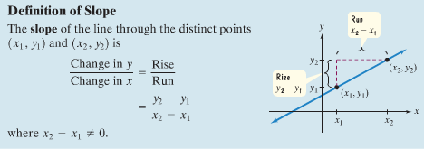

Slide 17
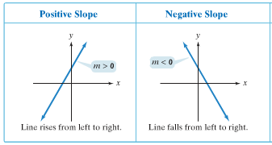
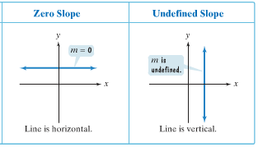

Slide 18
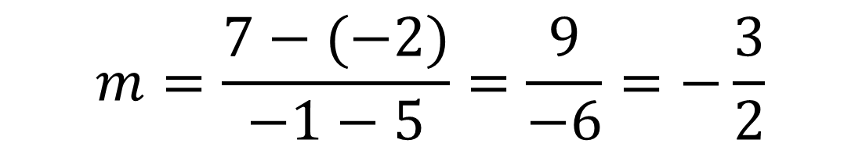
Example
Find the slope of the line passing through the pair of points. (5,-2) and (-1,7)

Slide 19
Examples:
Find the slope of the line passing through the points:
(6,1) and (-4,-1)
(4,-1) and (0,3)
m = 1/5
m = -1

Slide 20
Hw section 2.1
#1-27
19, 20 , and 21 go online to copy the right question.

